Slide 1
Prediction of Air Quality using Machine Learning Models
Final Review
1
Project Guide Name :
Mrs.A.Kanchana M.E.(Ph.D)
Assistant Professor
Project Co-ordinator :
Dr.K.Valarmathi Ph.D
Professor
Team members:
1.Preethi.R [2020PECCS161]
2.Pooja K [2020PECCS160]

Slide 2
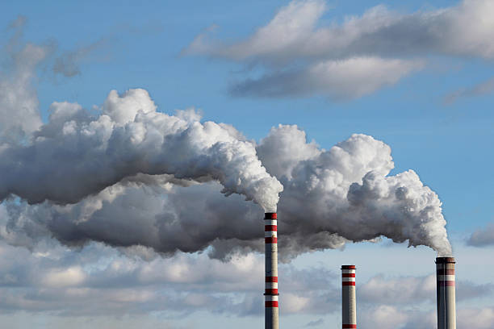
BASE PAPER
2
The base paper link is here :
Click here

Slide 3
ABSTRACT
3
This project employs deep learning models, specifically Long Short-Term Memory (LSTM),(Bi-LSTM) and Gated Recurrent Unit (GRU), to forecast air quality using a publicly available dataset from Kaggle.
The dataset encompasses air quality index (AQI) and pollutant measurements like CO, ozone, NO2, and PM2.5 from various global cities. After preprocessing the data, the models are trained, and their performance is assessed using Mean Squared Error (MSE) and R2 score.
The achieved R2 scores of 97% and 98% demonstrate the models' high efficacy in explaining the variance in air quality based on pollution measurements. These findings contribute to the understanding of deep learning applications in air quality prediction, showcasing potential applications in environmental monitoring and pollution control.

Slide 4
EXISTING SYSTEM
4
There are several methods from statistical to machine learning . Some of those existed methods are listed below:
Linear Regression: Predicting air quality based on linear relationships between predictor variables and air quality indices.
DISADVANTAGES: The disadvantages of this method are, it is sensitive to assumptions and limited complexity.
IoT and Air Quality Sensors: Deploying a network of sensors for real-time monitoring and prediction at specific locations.
DISADVANTAGES: The disadvantages of using sensor networks are
caliberation issues and limited coverage.

Slide 5
PROPOSED NETWORK
5
The proposed system is predicting the Air Quality using Machine Learning Models (LSTM ,BI-LSTM and GRU)
Here are some key advantages of the Proposed system:
1.Efficient Training: The gating mechanism helps the model focus on relevant information and ignore irrelevant inputs.
2. Effective for Time Series Prediction.
3.Less Susceptible to Overfitting: The gating mechanism in GRUs helps prevent overfitting by controlling the flow of information through the network.
4.Flexibility in Model Design: GRUs provide flexibility in designing models for various applications.

Slide 6
SOFTWARE REQUIREMENTS
6
Google collab
Datasets – Kaggle
Programming Language – Python
HARDWARE REQUIREMENTS
Operating System - Windows 8/10
IDLE - Python(3.10)

Slide 7
METHODOLOGY
7
Dataset Acquisition
Data Preprocessing
Data Split
Model Selection and Architecture
Model Training
Loss Evaluation
Model Evaluation

Slide 8
ALGORITHM (LSTM)
8
# Define LSTM model architecture
model = Sequential()
model.add(LSTM(units=50, return_sequences=True, input_shape=(X_train.shape[1], X_train.shape[2])))
model.add(Dropout(0.2))
model.add(LSTM(units=50, return_sequences=True))
model.add(Dropout(0.2))
model.add(LSTM(units=50))
model.add(Dropout(0.2))
model.add(Dense(units=1))
# Compile the model
model.compile(optimizer='adam', loss='mean_squared_error')
# Train the model
history = model.fit(X_train, y_train, epochs=100, batch_size=32, validation_data=(X_val, y_val), shuffle=False)

Slide 9
ALGORITHM(LSTM)
9
# Plot training and validation loss
plot_loss(history)
# Make predictions
predictions = model.predict(X_test)
# Evaluate the model
mse = mean_squared_error(y_test, predictions) print("Mean Squared Error:", mse)

Slide 10
ALGORITHM(Bi-LSTM)
10
# Define BI-LSTM model architecture
model = Sequential()
model.add(Bidirectional(LSTM(units=50, return_sequences=True), input_shape=(X_train.shape[1], X_train.shape[2])))
model.add(Dropout(0.2))
model.add(Bidirectional(LSTM(units=50, return_sequences=True)))
model.add(Dropout(0.2))
model.add(Bidirectional(LSTM(units=50)))
model.add(Dropout(0.2))
model.add(Dense(units=1))
# Compile the model
model.compile(optimizer='adam', loss='mean_squared_error')
# Train the model
history = model.fit(X_train, y_train, epochs=100, batch_size=32, validation_data=(X_val, y_val), shuffle=False)

Slide 11
ALGORITHM (Bi-LSTM)
11
# Plot training and validation loss
plot_loss(history)
# Make predictions
predictions = model.predict(X_test)
# Evaluate the model
mse = mean_squared_error(y_test, predictions)
print("Mean Squared Error:", mse)

Slide 12
ALGORITHM(GRU)
12
# Define GRU model architecture
model = Sequential()
model.add(GRU(units=50, return_sequences=True, input_shape=(X_train.shape[1], X_train.shape[2])))
model.add(Dropout(0.2))
model.add(GRU(units=50, return_sequences=True))
model.add(Dropout(0.2))
model.add(GRU(units=50))
model.add(Dropout(0.2))
model.add(Dense(units=1))
# Compile the model
model.compile(optimizer='adam', loss='mean_squared_error')
# Train the model
history = model.fit(X_train, y_train, epochs=100, batch_size=32, validation_data=(X_val, y_val), shuffle=False)

Slide 13
ALGORITHM(GRU)
13
# Plot training and validation loss
plot_loss(history)
# Make predictions
predictions = model.predict(X_test)
# Evaluate the model
mse = mean_squared_error(y_test, predictions)
print("Mean Squared Error:", mse)

Slide 14
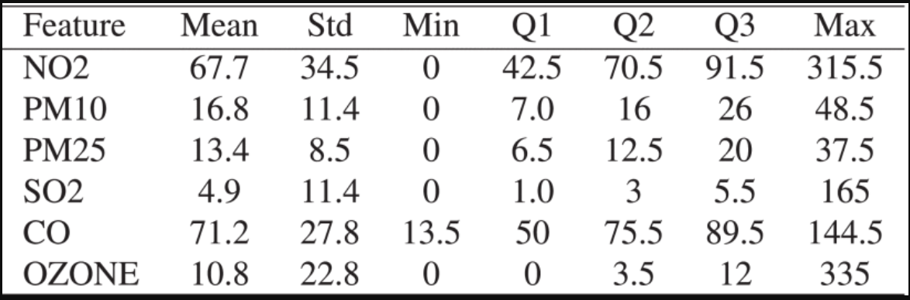
Data Preprocessing
14

Slide 15
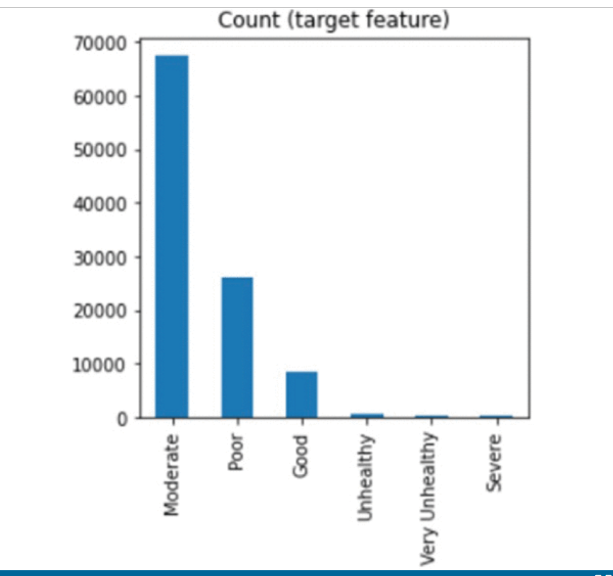
Balancing Data
15

Slide 16
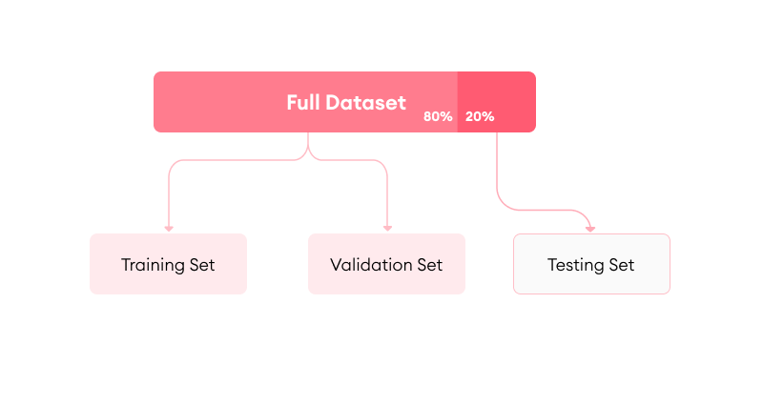
TRAINING AND TESTING
16

Slide 17
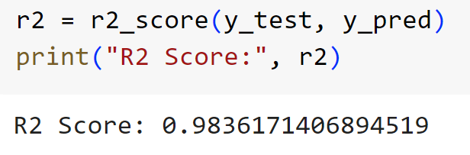
MODEL EVALUATION
17

Slide 18
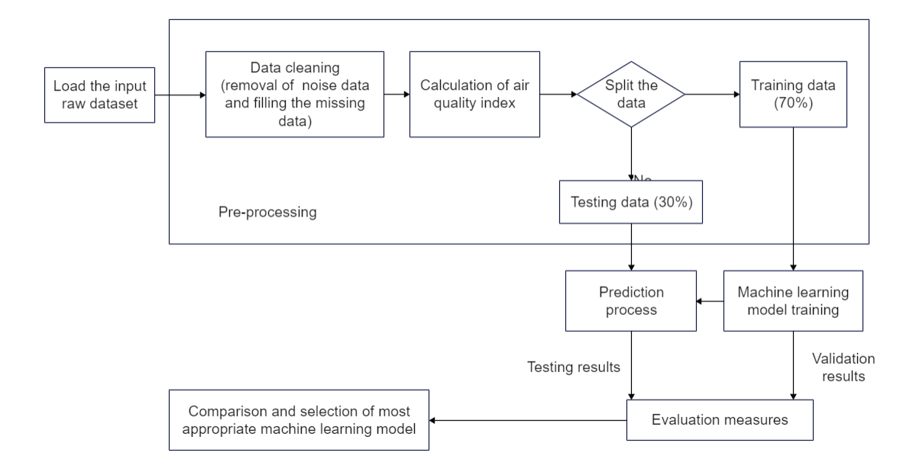
ARCHITECTURAL DIAGRAM
18

Slide 19
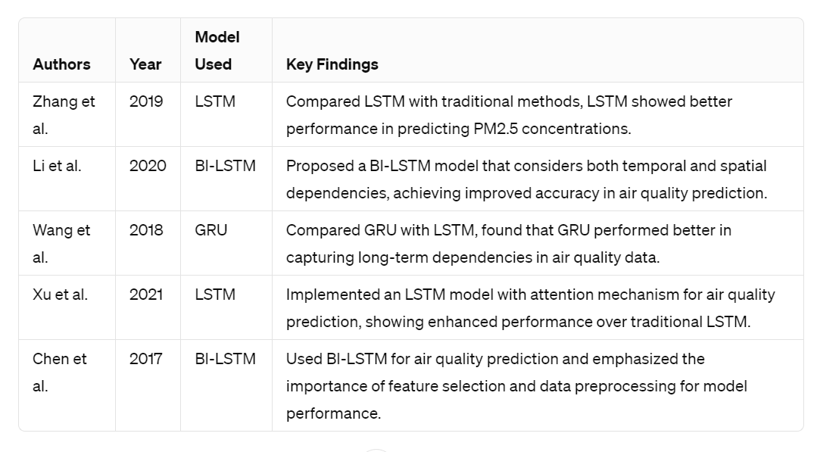
LITERATURE SURVEY
19

Slide 20
REFERENCES
20
1. M. Ma, P. Xie, F. Teng, T. Li, B. Wang, S. Ji, et al., "HiSTGNN: Hierarchical spatio-temporal graph neural networks for weather forecasting" in arXiv:2201.09101, 2022.
2. Z. Zhang, H. Chen and X. Huang, "Prediction of air quality combining wavelet transform DCCA correlation analysis and LSTM model", Appl. Sci., vol. 13, no. 5, pp. 2796, Feb. 2023.
3. J. Han, H. Liu, H. Xiong and J. Yang, "Semi-supervised air quality forecasting via self-supervised hierarchical graph neural network", IEEE Trans. Knowl. Data Eng., Feb. 2022.
4. R. S. Ram, K. Venkatachalam, M. Masud and M. Abouhawwash, "Air pollution prediction using dual graph convolution LSTM technique", Intell. Autom. Soft Comput., vol. 33, no. 3, pp. 1639-1652, 2022.

Slide 21
THANKYOU !
21

